Slide 1
Agile Team Practices
-Scrum Core

Slide 2
Overview
What is Agile/ Why it works 什么是敏捷/为什么选择敏捷
Agile Requirements and Estimation 敏捷中的需求与估算
Scrum
Scrum Roles 角色
Scrum Artifacts 资产
Scrum Event 事件
Scrum Values 价值观
Agile Planning 敏捷中的计划
Agile Practices 敏捷实践

Slide 3

敏捷 VS 快速

Slide 4

Warm up!

Slide 5
What is Agile? 什么是敏捷
Agile is a State
敏捷是一种状态
Methodology？
Process？
Agile
Framework？
从产出来看（from delivery perspective）
频繁地交付可见的、可用的成果（软件）
从团队来看（from team perspective）
主动地、持续地学习和改进

Slide 6
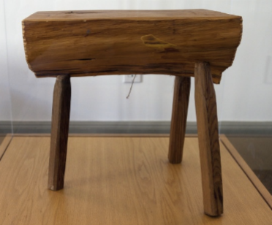
Empirical process 试验性过程
三大支柱
Transparency 透明
Inspection 检验
Adaptation 适应

Slide 7
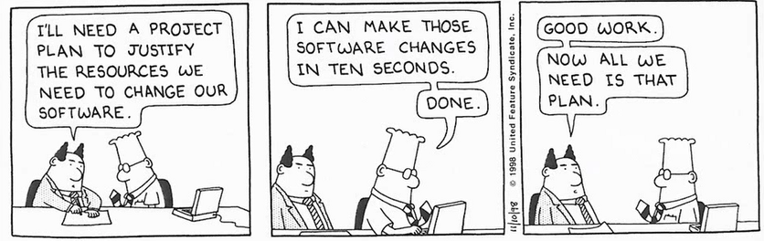
Agile VS Waterfall（Plan driven）

Slide 8
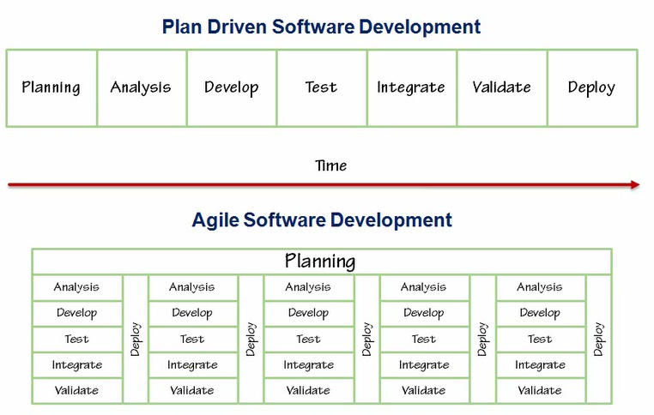
Winston Royce's Waterfall Model

Slide 9
Values （Agile Manifesto） 价值观 （敏捷宣言）
Individuals and interactions over processes and tools
个体与交互 高于 流程和工具
Working software over comprehensive documentation
工作的软件 高于 详尽的文档
Customer collaboration over contract negotiation
客户合作 高于 合同谈判
Responding to change over following a plan
响应变化 高于 遵循计划

Slide 10
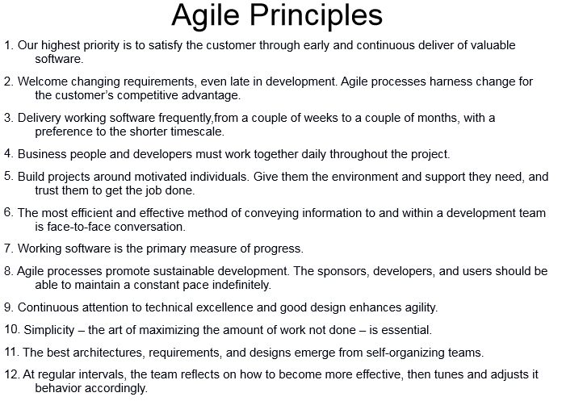

Slide 11
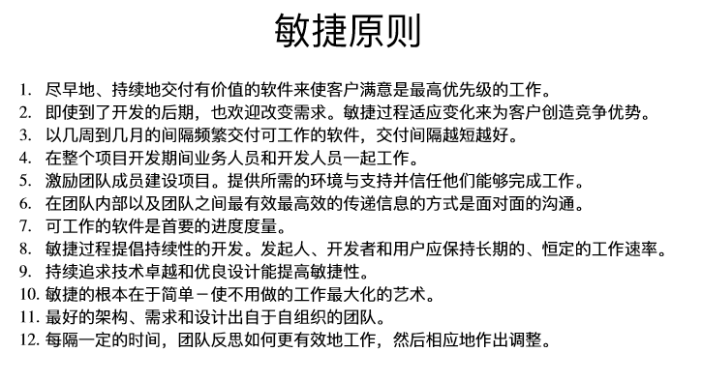

Slide 12
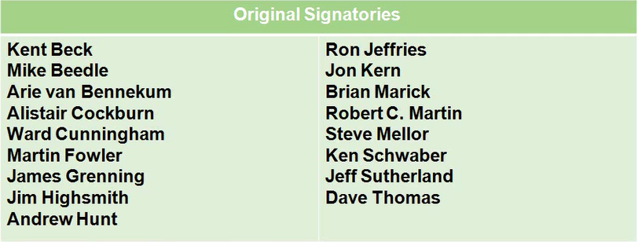

Slide 13
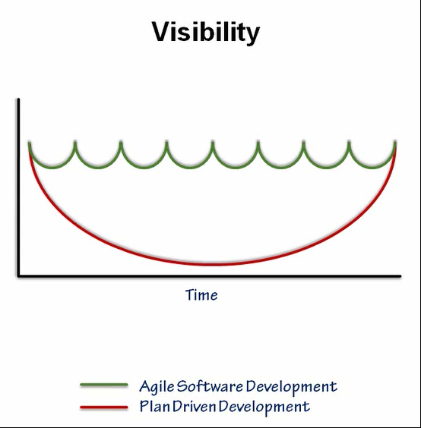

Slide 14
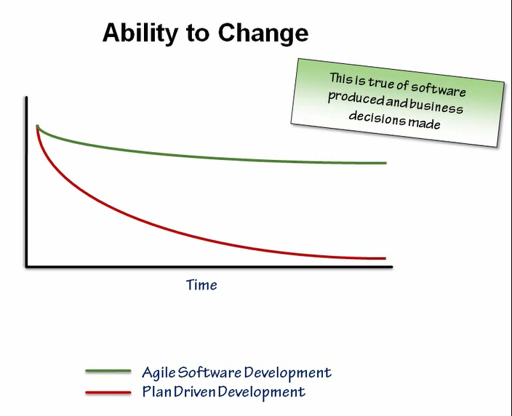

Slide 15
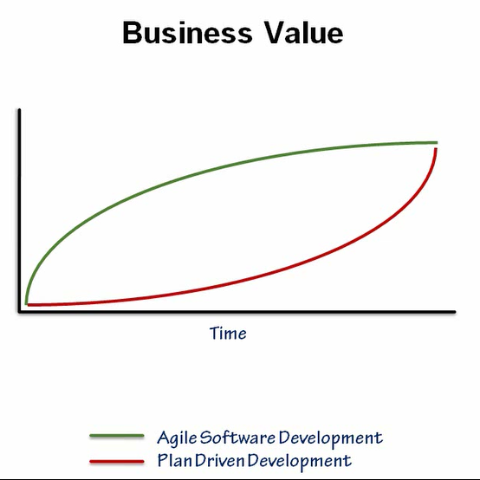

Slide 16
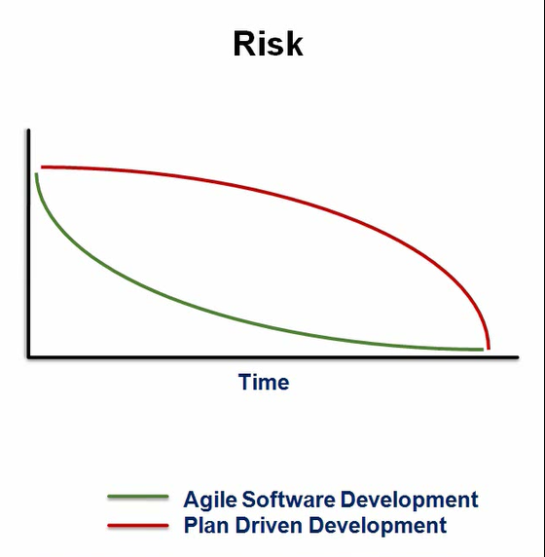

Slide 17
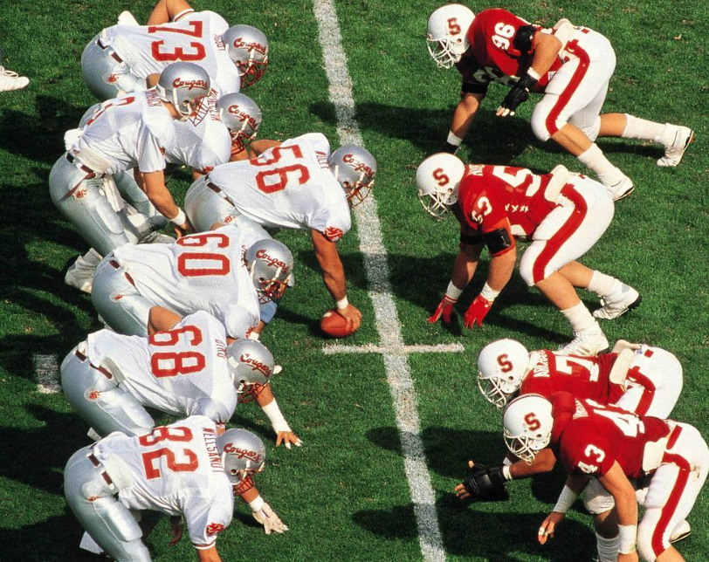
Scrum 起源

Slide 18
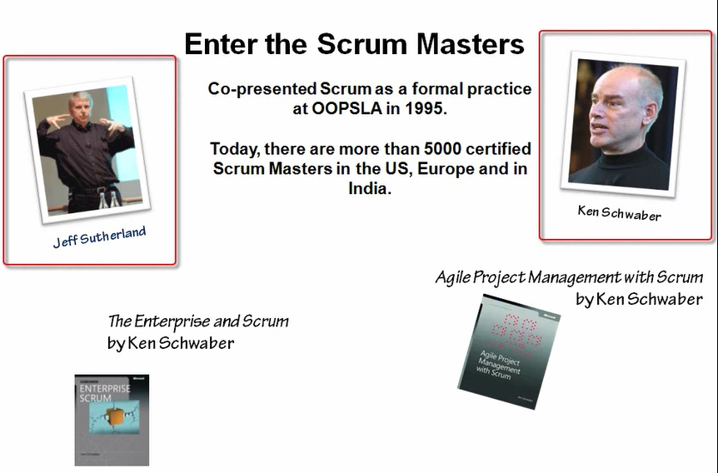

Slide 19
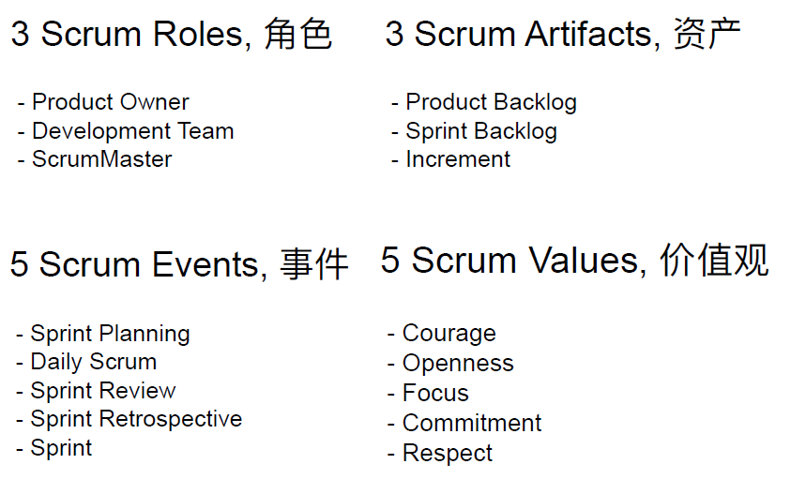
What’s scrum - scrum is a framework

Slide 20
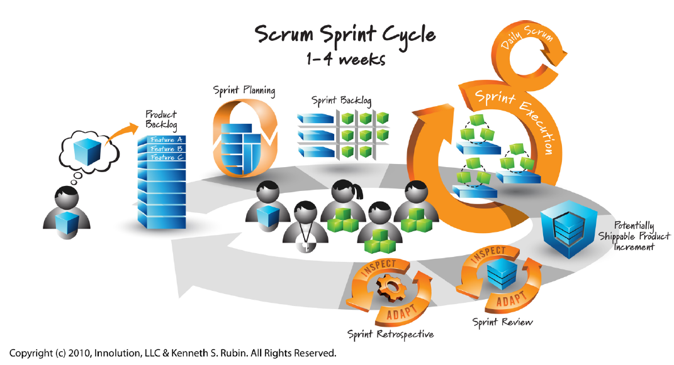

Slide 21
Agile requirements and estimation - effective requirements
Requirements specifications, Software requirements specification, Use-cases, Features, User Stories, etc.
需求规格，软件需求规格（SRS）， 用例，功能，用户故事， 等
We like User Stories

Slide 22

User story
卡片
交流
确认

Slide 23
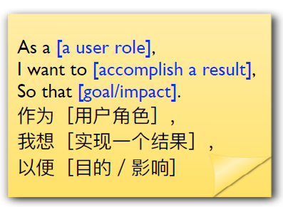
User story
Start with WHY
Concise written description of a piece of functionality valued and verifiable by the user
使用简单的书面描述，定义一小片用户可以评估、验证的功能

Slide 24
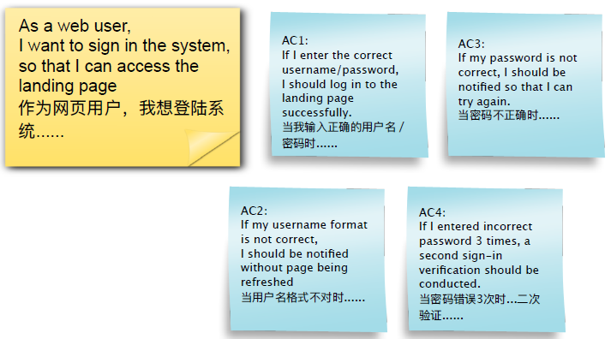
User story and Acceptance criteria 用户故事和验收标准

Slide 25
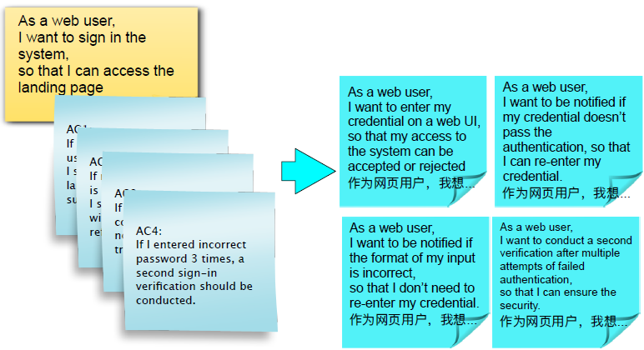
Epic & Implementable stories 史诗与可实现级用户故事

Slide 26
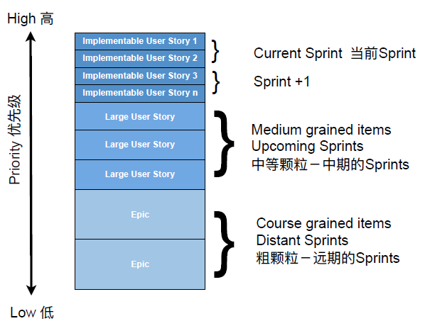
User Stories Granularity 用户故事的粒度

Slide 27
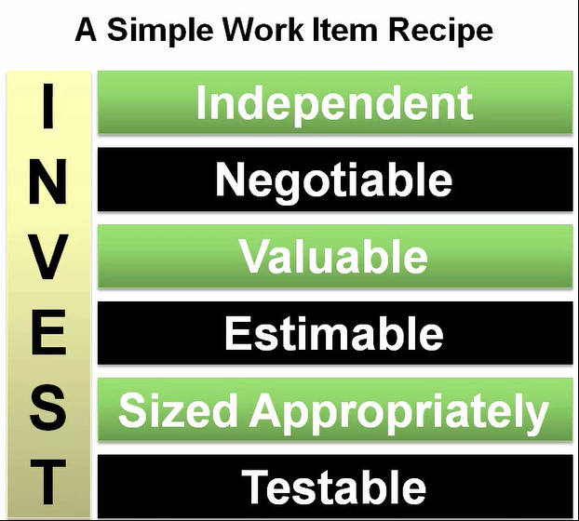
Invest 原则
Small

Slide 28
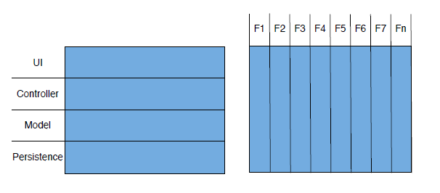
Traditional vs Agile 传统 vs 敏捷 Horizontal vs vertical 横切 vs 纵切

Slide 29
Break down requirements 切割需求的一些思路
User Roles 从用户角色细分
User Operations 从用户操作细分
Data Objects 从数据细分
Work Flows 从工作流程细分
Business Logics 从业务逻辑细分
Simple/Complicated Scenarios or Rules 从简单/复杂的情景或规则细分
Acceptance Criteria 从验收接受条件细分
Functional vs. Non-Functional 从功能性及非功能性细分
Essential， Flexibility， Safety……从必要性、灵活性、安全性……细分

Slide 30
Estimate
The Typical Estimation Process
Agile – Story Point
1 SP vs 2 SP?
17 SP vs 18 SP?
99 SP vs 100 SP?
Use units that make sense
XS, S, M, L, XL, XXL
1,2,3,5,8,13,20,40
1,2,4,8,16,32
Include big and small outliers if you want.
0, ½, 100, 300, ∞

Slide 31

It’s called an estimation
Not a promise. Don’t worry so much.
Remember why estimates are needed
Large scale planning
Get a feel for cost

Slide 32
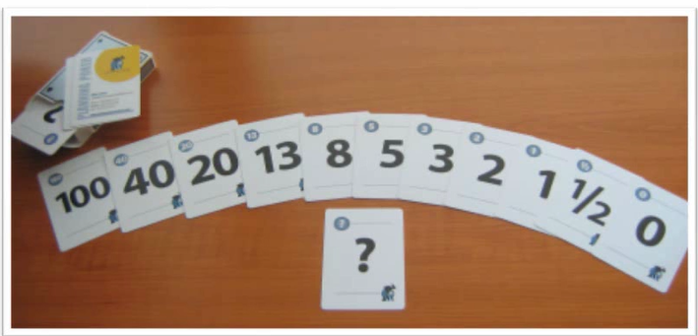
Planning poker
Emphasizes relative sizing
体现大小
Everyone is heard
每个人都听到
Finds hidden requirements and details
找出隐含的需求和细节
Estimators must justify estimates
估算人必须证明估算是有道理的
It’s iterative
不断重复
It’s quick 快速
It’s fun 有趣

Slide 33
Planning poker rules
Each estimator has a desk of cards estimation cards.
Customer/Product Owner reads a story and it’s discussed briefly.
Each estimator selects a card that’s his or her estimate.
Cards are turned over so all can see them.
Discuss differences
Re-estimate until estimates converge.

Slide 34
Product backlog
A dynamic list of functionality the product might include
一份动态的列表，包含了产品可能具备的功能
And other work providing value to the user
以及其他为用户带来价值的工作
A healthy product backlog must be DEEP
Detailed appropriately 恰当的详细程度
Estimated 已估算
Emergent 涌现式
Prioritized 优先级排序
Open to all but ultimately groomed by the PO 对所有人开放但最终由PO维护
Focus on ‘WHAT’ brings users the biggest value 关注于“什么”带给用户最大的价值
The best Product Owner starts with ‘WHY’ 最优秀的PO从“为什么”开始

Slide 35
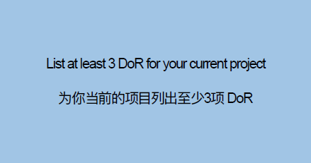
Prioritization Techniques 优先级排列技巧
Definition of Ready （DoR）

Slide 36
Product backlog refinement 产品backlog梳理
Purpose； 目的
When to do?; 什么时候做？
Who to do?; 什么人来做？
Max 10% of total Sprint efforts; 最多花费10%的Sprint的工作量

Slide 37
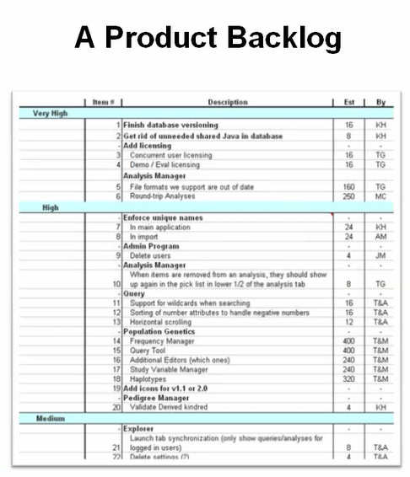
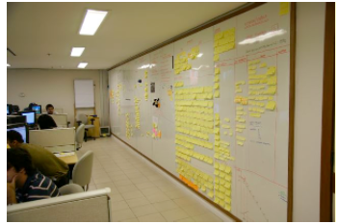

Slide 38
Sprint backlog
Extension and subset of the product backlog 产品Backlog的延伸和子集
The set of work to achieve the Sprint Goal 为实现Sprint目标所要完成的工作集
JIT (Just In Time) design in considered 涵盖‘恰到好处’的设计
Breaks large work down into smaller pieces (PBI -> SBI) 将大块工作分解成更小的单元
Start to focuses on “HOW” team is going to get the work done and deliver the value in one sprint 开始关注“怎么做”的问题：如何在一个Sprint内完成工作以交付价值
Owned by Development Team 被开发团队拥有
Team selects items from the product backlog they can commit to completing and creates the sprint backlog 团队从Product backlog中选取他们可以承诺完成的项目并创建Sprint backlog
Collaboratively, not done alone by the Scrum Master 协作完成，不是由SM负责
A visible tool for the team to manage itself during the sprint 一个可视化的工具让团队在sprint内部自我管理

Slide 39
Managing Sprint backlog
Task board is a common visible tool to manage sprint backlog 任务板是一个常见的用于管理sprint backlog的可视化工具
Self-organized (Swarming): Individuals or small groups sign up for work 自组织（蜂群）：团队成员或小组自己领取工作
Team decomposes PBI to SBI 团队一起将PBI分解为SBI
Team decides SBI granularity 团队决定合适的SBI颗粒度
Work is not assigned 任务不应该被分配
Sign up for new work after one work is done 完成一项任务才认领另外一项
Based on priority and try to reach fully DONE on a PBI 基于优先级，努力使一个PBI尽早完全完成
Team track remaining work of the Sprint, daily 团队每天跟踪Sprint的剩余工作
Any team member can add, delete or change the sprint backlog item (SBI) (task level) 任何团队成员都可以添加、删除或变更SBI
Work (task items) for the sprint may emerge sprint内的工作任务有可能动态涌现

Slide 40
Potentially Shippable Product Increment
(PSP)
潜在可交付产品增量

Slide 41
Increment 增量
The sum of all the Product Backlog items completed during a Sprint and all previous Sprints 当前Sprint以及所有已完成Sprint内，已完成的Product Backlog项的总和
Potentially shippable and meet the Definition of Done 潜在可交付，并符合完成的定义
Must be in useable condition regardless whether the Product Owner decides to release it 必须是可用的产品，不管PO是否决定对外发布

Slide 42
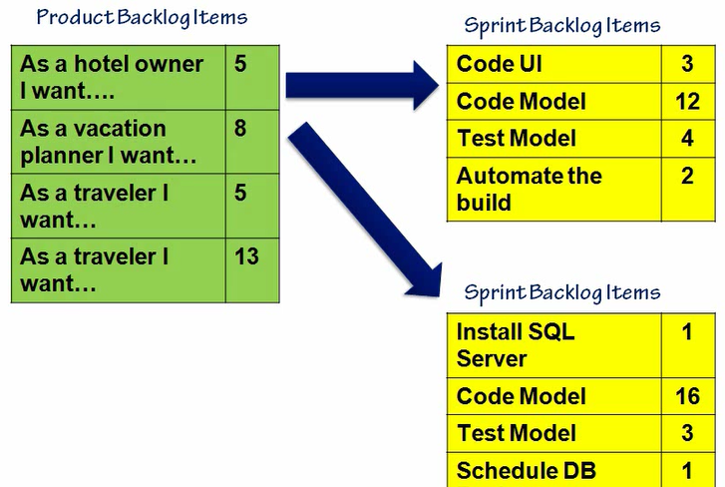
Product backlog Item VS Sprint Backlog Item

Slide 43
About Tasks
The real work is the PBI
Tasks don’t typically need a lot of detail
These items represent a conversation
Simply meant to be a TODO item
Keep it simple

Slide 44
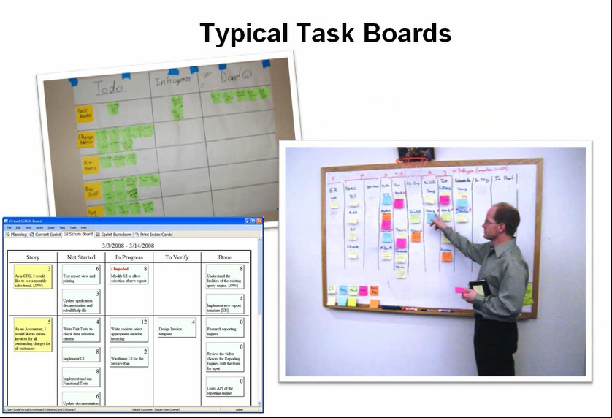
Task boards
Visible to the world
Update in real time
Represents the current progress toward the Sprint Goal
Work visibility management tool for the team

Slide 45
石头的寓言 （The parable of stones）
By Steve Jobs
Courage, Openness, Focus, Commitment, Respect
勇气、开放、专注、承诺、尊重

Slide 46
Chickens and pigs
Chickens | Pigs
Managers | Team Members
Executives | Scrum Master
Anyone on another team | Product Owner
Pigs have skin in the game.
Chickens don’t

Slide 47
The development team
5-9 people (7±2)
Cross-functional 跨职能
All skill set in different functional areas; 具备不同领域的必需技能
Different maturity levels; 不同层面的成熟度
“T” model person; “T”模型人才
Full-time
Membership changes only between sprints
Self-organized
No management title; 没有管理者头衔
Team decides how to work; 团队决定如何去工作
Whole team accountability; 全员责任制
Team takes most of the micro management work; 团队承担大部分微观管理工作

Slide 48
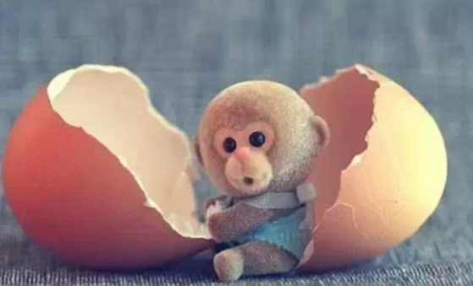



Result？

Slide 49
The development team – mission 开发团队 – 使命
Deliver Product Increments 交付产品增量
Responsible for HOW & quality of delivery 对“怎样做”和交付质量负责
Participate in Sprint events 参与Sprint中的所有会议
Manage Sprint backlog and track the progress 管理Sprint Backlog 并跟踪进度
Figure out the best way to work together as a team 找到团队内部合作的最佳方法
Collaborate with other teams and parties 与其他团队及相关方协作
Make continuous self improvements 持续自我改进

Slide 50
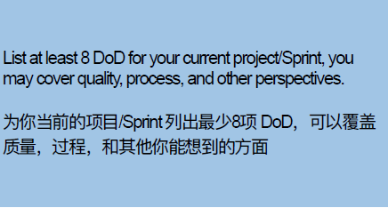
Definition of Done (DoD) “完成”的定义

Slide 51
The product owner – characteristics Product owner – 特征
One person playing the role
Authorized to make decision on WHAT; 被授予产品决策权 （做什么）
Drives product success; 驱动产品走向成功
Provide leadership on product; 提供产品领导力
Represent project to the stakeholders; 面向干系人代表团队
Represent stakeholders to the team; 面向团队代表干系人
Collaborates with everyone; 和所有人合作

Slide 52
The product owner – mission The product owner – 使命
Create the Product Vision； 建立产品愿景
Start with “WHY”; 从“为什么”开始
Defines the feature of the product (the “WHAT”)；定义产品功能 （“做什么”）
Responsible for Return of Investment (ROI); 负责最大化投资回报
Orders/Prioritizes Product Backlog to best achieve goals; 为最好地实现业务目标将PB排定顺序/优先级
Decides on Release date and content; 决定版本发布日期和内容
Adjust Product Backlog/ priority according to the feedback; 根据反馈调整产品Backlog或优先级
Participates in Sprint events; 参与Sprint事件
Be committed to collaborate and be available; 愿意投入到合作中并且在需要时被找到
Accept/reject work result; 接受或退回工作成果

Slide 53
The scrum master – characteristics The scrum Master – 特征
Represents project to the management; 面向管理层代表团队
Represents management to the team; 面向团队代表管理层
Not a traditional project manager or team manager;
No management title – CANNOT make decisions on behalf of the team;
Is a servant leader; 是一个仆人式的领导
Authorized to be a sheep-dog
Coaching the team rather than being a player
Change agent of team and organization; 团队和组织谋求变化的代理人
Good techniques on facilitation etc.; 具备良好的引导技能
Listens much more than tell;
Be open-mind;

Slide 54
The scrum master – mission the scrum master – 使命
Responsible for enacting Scrum values, principles and rules; 负责Scrum价值观、原则和规则被采纳和体现
Remove impediments; 移除障碍
Serves the Product Owner and team; 为PO和团队服务
Help to develop the team; 帮助培养团队
Protects the team; 保护团队
Facilitates team collaboration/productivity; 辅助团队高效协作
Work to improve effectiveness of Scrum in the organization; 想办法提升Scrum在整个组织中的效果

Slide 55
Scrum master common focused areas Scrum master的关注领域
Ceremonies and Meetings 仪式和会议
Team Facilitation 团队引导
Learning & Team Development 学习及团队发展
Product Owner and Backlogs 产品负责人及Backlogs
Beyond Team (Organizational, cross-team, upper management…) 超越本团队 （组织的、跨团队的、上层管理…)
Coaching Perspectives 对教导的看法
Process Coaching 过程教练
Performance Coaching 绩效教练

Slide 56
The scrum master as a team coach – core competences scrum master 作为团队教练 – 核心技能
Facilitating Skills; 引导技能
Teaching Skills; 培训技能
Mentoring Skills；辅导技能
Coaching Skills; 教导技能

Slide 57
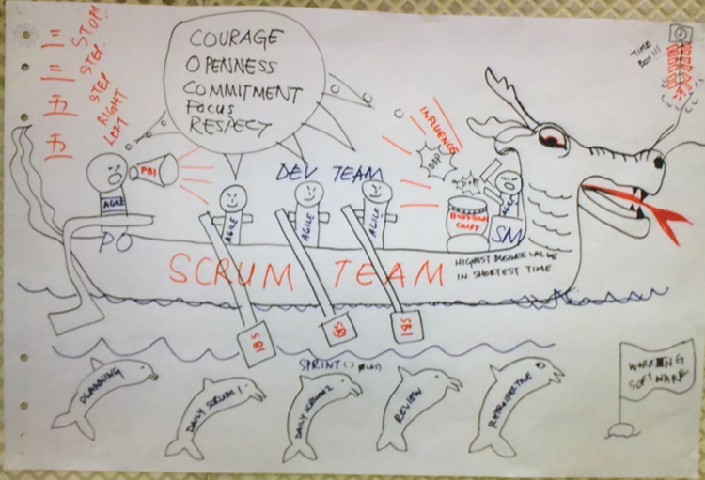
Different scrum roles in one team Scrum团队中的不同角色

Slide 58
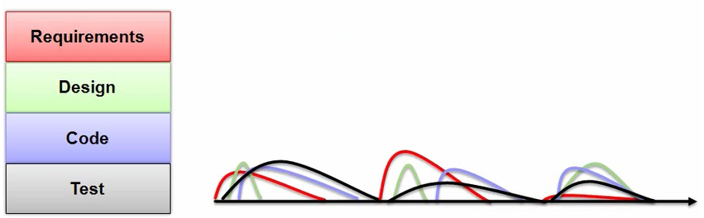
Sprint
Scrum projects make progress in a series of “sprint” / Scrum 项目由一系列的Sprint组成
Analogous to Extreme Programming iterations 借鉴了极限编程中的“迭代”
Typical duration is 2-4 weeks or a calendar month at most 通常2-4周，最多一个月的日历时间，或者更短
A constant duration leads to a better rhythm 定长的sprint有利于更好的交付节奏
Product is designed, coded, and tested during the sprint

Slide 59

Sprint
Goals Don’t Change in the Sprint
不要更改Sprint的目标
Don’t Change Sprint length during a Sprint
不要改变运行中的Sprint的长度

Slide 60
Sprint
Can a Sprint be terminated? Sprint可以被中止吗？
Yes
Product Owner can cancel the Sprint if business circumstances require
出于业务需要， PO可以取消Sprint
Team can discuss with Product Owner to see how to handle, if they are unable to accomplish anything
如果无法完成任何东西，团队可以和PO协商
Go back to Sprint planning – any undone work performed should be put back to Product Backlog
重新做Sprint计划 – 所有未完成的工作返回产品backlog
Very rarely done！罕有发生

Slide 61
Before first sprint
What is your team’s Working Agreement, also you may include your tools and process you will use. 你的团队的工作约定协议是什么？讨论确定你们将使用的工具和工作流程
Perform Backlog Refinement (Using DoR/ AC/ How to Demo) 进行一次Backlog梳理 （使用DoR/ 验收标准/ 怎样演示）
What is your Sprint’s DoD? 你的Sprint完成的定义是什么

Slide 62
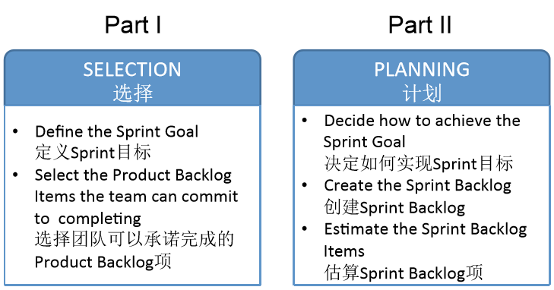
Sprint Planning meeting
Timebox: max 8 hours for 1 month Sprint,
时间盒： 1个月的Sprint最长8小时

Slide 63
Sprint planning meeting
Part I
参与者： PO/ Development Team/SM
输入：Healthy Product Backlog
输入：Latest Increment 最新的版本增量
输入：Capacity/ Velocity of the Development Team of this Sprint
输出：Selected Product Backlog Items representing the Sprint Goal 代表这个Sprint目标所一起选择的产品Backlog项
Part II
参与者：Development Team/ PO / SM
输出： Plan on how to meet the Sprint Goal (Sprint Backlog) 如何实现Sprint目标的工作计划
输出： Mutual agreement on the Sprint Goal 大家对Sprint目标形成共识

Slide 64
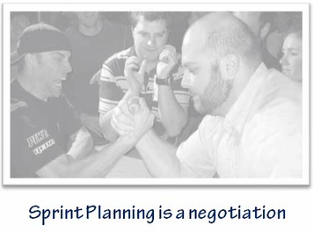
Sprint planning meeting
What Gets Done
Sprint goals are created
The Sprint Backlog is created
A Burndown chart is initialized

Slide 65
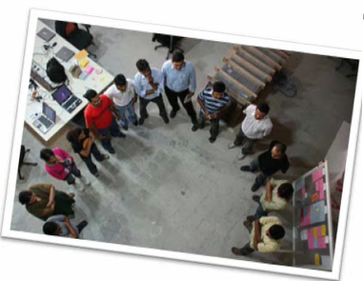
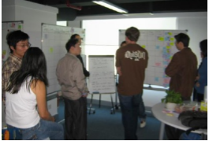
Daily Scrum
This actually avoids other meetings.
Really!
Team focuses together once per day
Ideally in the morning, to set direction for the day
Same time each day
Ideally, same place each day
Time boxed, typically 15 minutes
Participants：Development Team, SM, PO (only “Pig”)
Standing up rule helps the time box rule
Scrum Master facilitates

Slide 66
The daily scrum
Each Team member answers
What did you do yesterday?
What will you do today?
What impediments are in your way?
It is common to update the Sprint Backlog and Sprint Burndown chart at the Daily Standup
This is NOT status for the Scrum Master, it is broadcast in front of peers for self-management
不是向Scrum Master汇报状态，而是向所有组员的广播，属于自管理的一部分

Slide 67
Keeping it fun an interesting
Last person to arrive starts the meeting
Bring food
Changing up the order
Draw cards
Round robin
Pass the token

Slide 68
Daily standup smells
Starting late
Missing pigs
The meeting overlord
Squawking chickens
Gloom and doom
Impediments aren’t raised
Impediments aren’t resolved
The story teller

Slide 69

Sprint review
Inspect & adapt on the Product and Product Backlog
Team presents what it accomplished during the sprint
Product Owner accept “Done” work and rejected “un-done” work
Typically takes the form of a demo of new features or underlying architecture
Informal
4 hours max time-box for 1 month Sprint
No slides
Whole Scrum team participates
All stakeholders and interested parties are invited (include “Chicken”)
Feedback informs future work

Slide 70

The sprint retrospective
This is the Kaizen part (Continuous Improvement)
Inspect & adapt on how we work
Typically 30-60 minutes
Time-box: 3 hours max for 1 month Sprint
Whole Scrum team participates
Other interested parties are welcome by invitation

Slide 71
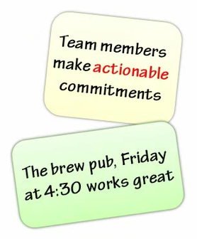
Sprint Retrospective
Answer these questions
What will we start doing …
What will we stop doing …
What will we continue doing …
… in the next Sprint ?

Slide 72
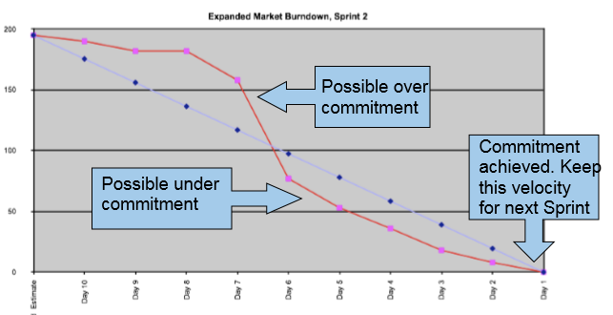
Sprint burndown charts
Update daily, usually after the daily stand-up
Represent the amount of work remaining
Different approaches to creating burndown chart 燃尽图有不同思路
Estimated remaining efforts
Tracking Done

Slide 73
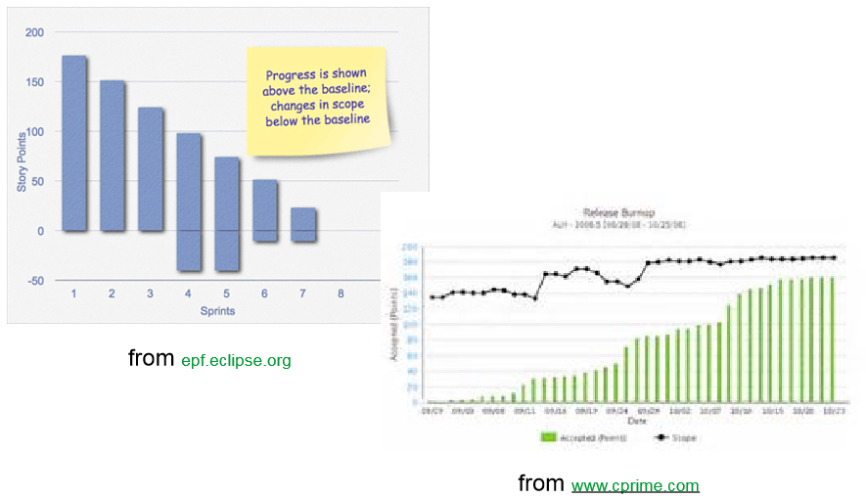
Release burndown & burnup

Slide 74
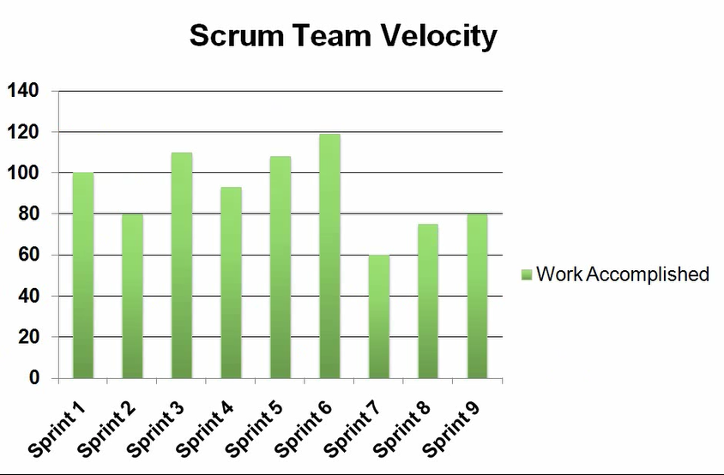
Scrum team velocity
Velocity = how many Story Points team can deliver in one sprint
Velocity is historical data
Best Guess before Sprint 1
Used to inform the Team when pulling work
Used to PO to plan releases and future work
Measuring only “Done”

Slide 75

Velocity?
Sprint II
Task | Story Point | Complete
Story 1 | 7 | Done
Story 2 | 9 | Done
Story 5 | 3 | Done
Story 6 | 2 | Done
Story 4 | 10 | 30% Done

Slide 76
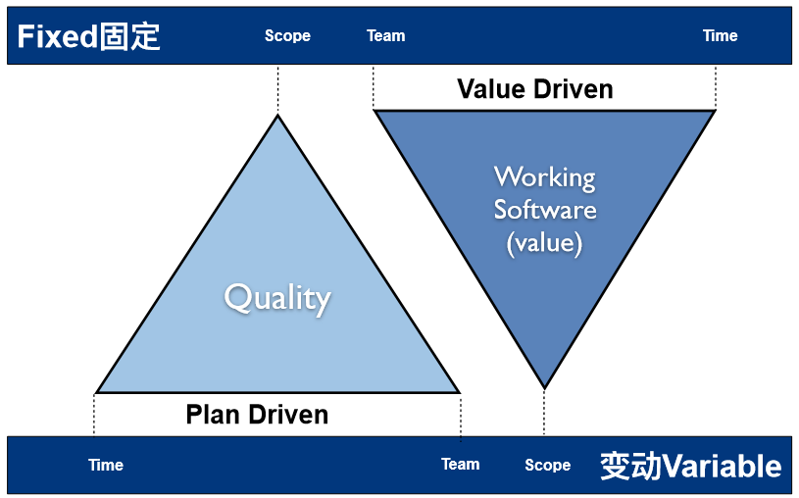
Project Management Triangle 项目管理铁三角

Slide 77
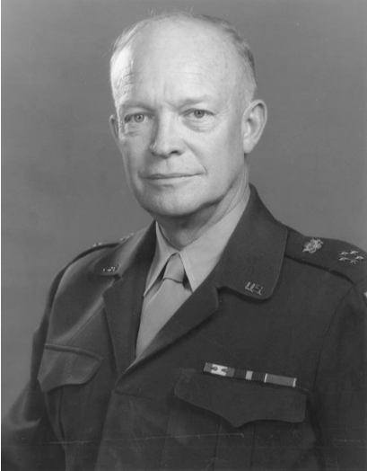
Plans are nothing;
Planning is everything
- Dwight D. Eisenhower

Slide 78
Agile planning
Why we need plans?
Reduce risk
Make informed decision
Reduce uncertainty
Establish trust
So customers can depend on you

Slide 79
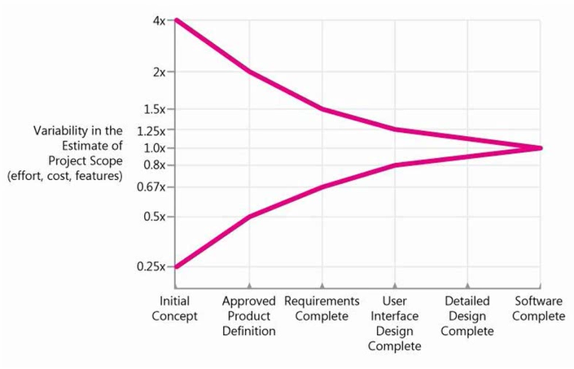
Cone of Uncertainty
This is when projects are typically funded

Slide 80
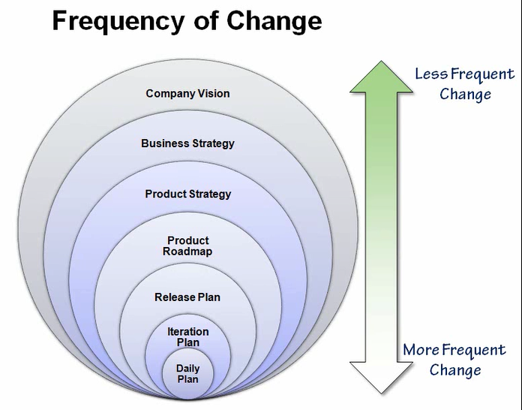

Slide 81
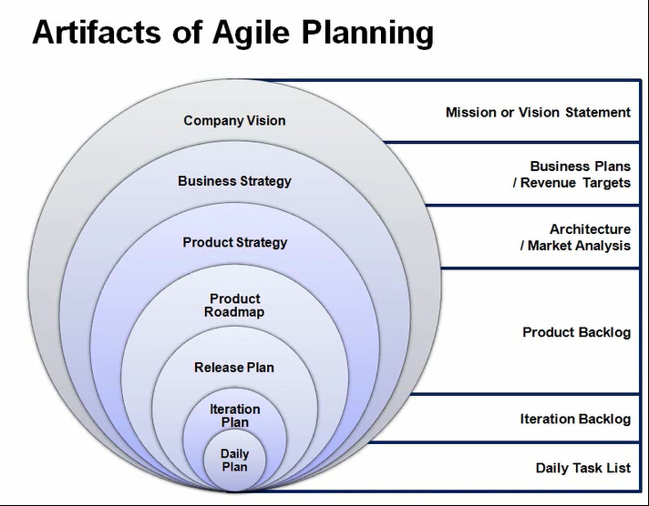

Slide 82
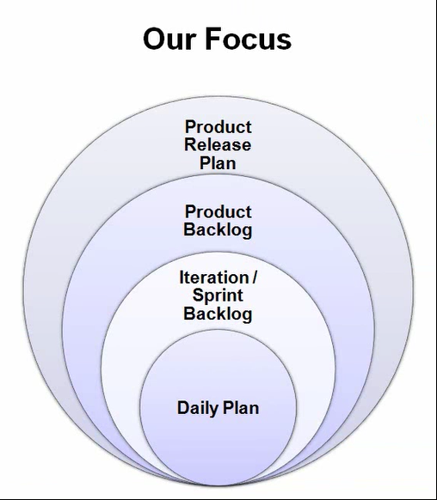

Slide 83
2 Rules
Rule #1 – An accurate release plan requires a prioritized and estimated backlog
Rule #2 – An accurate release plan requires known velocity

Slide 84
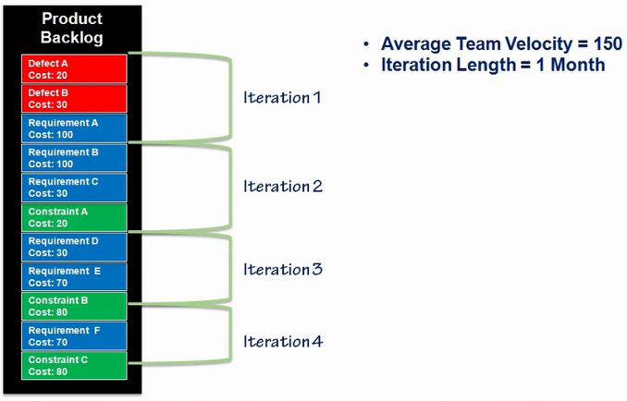
When will requirement F likely ship?

Slide 85
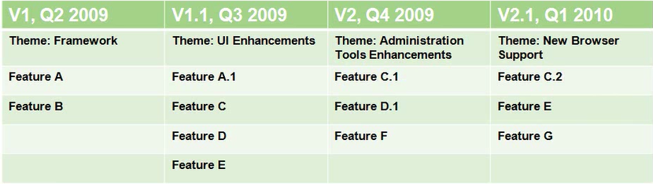
A typical release plan

Slide 86
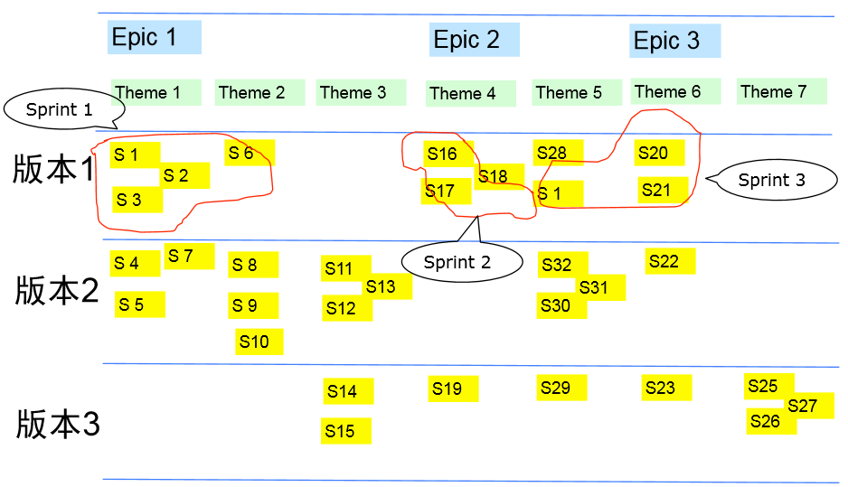
多阶段发布计划的一种方式： Story Map （故事图谱）

Slide 87
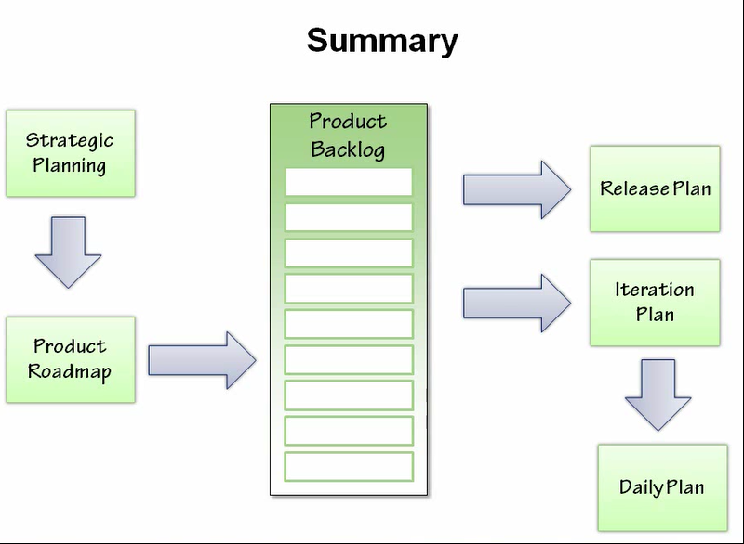

Slide 88
Enterprise Scrum Getting big without getting slow
Scrum of Scrums
Multiple or Large Backlogs
Scrum in the Plan Driven Organization
Measurements

Slide 89

Scrum of Scrums
A Scrum for Scrum Master
Not necessarily Time Boxed to 15 minutes
Need not occur daily
Attendees must be able to make resource decisions
May include other organizational leaders

Slide 90
Meeting agenda
Time Boxed 15m | Each Scrum Master answers: What has your team done since we last met? What will your team do before we meet again? Is anything slowing your team down or getting in their way? Are you about to put something to another team’s way?
Not Time Boxed | Ad-hoc discussion To remove impediments To sync up activities

Slide 91
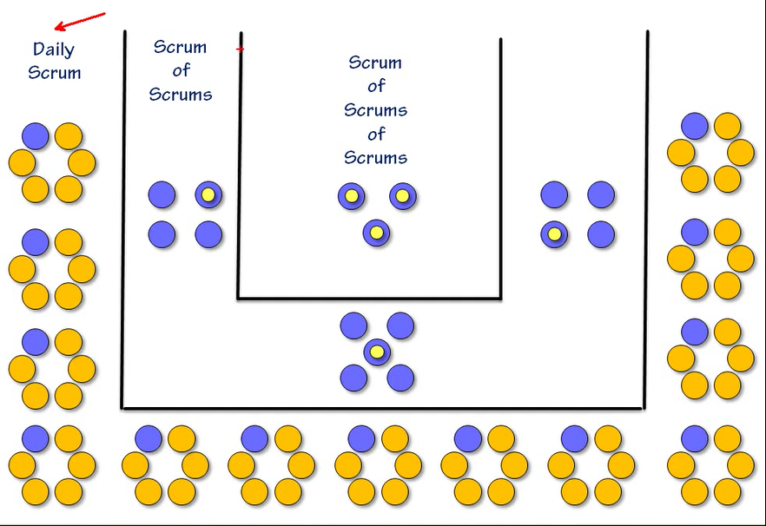

Slide 92
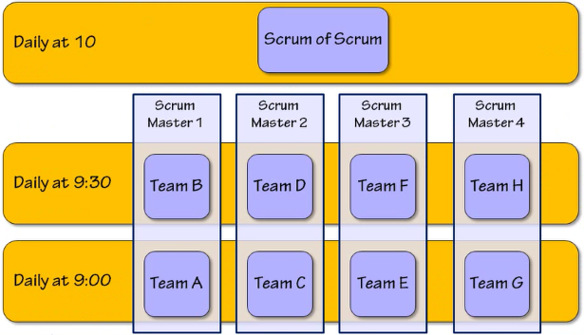
A real scrum of scrums model

Slide 93

Many, many teams, one huge product

Slide 94

Rolling Backlog planning

Slide 95
Co-existence models
Waterfall at the end
Irritating
Waterfall Up Front
Painful
Waterfall in Tandem
Deadly

Slide 96

If scrum mast co-exist
Do somethings anyway
Engineering practices
Daily standup
Frequent Reviews
Demonstrate progress
Information share
Find small work batches
Large specifications can be thin-sliced
Deliver to the specification, incrementally
Try submitting Agile metrics along with other required ones

Slide 97
If scrum mast co-exist
Add PBIs for
Documents
Analysis activity
Checklists
Other Plan-Driven deliverables

Slide 98
Other agile metrics
Defect Count
Total active, open defects
Relative to Acceptable Defect Ceiling
Sprint Cumulative Flow ; Sprint 积累
Total work to deliver a Sprint changing over time
The rate at which the Team are completing the Sprint Backlog
The amount of work In Progress at any time
Product Backlog Depth
Long Product Backlogs are wasted work
150 Items is a ceiling
3 Sprints of Items is a Floor

Slide 99

% Earned value burn up
Shows delivery of Business Value
Can show ROI
Great for executive briefs

Slide 100
Code focused metrics
Code Coverage
% of LOC exercised by unit tests
Indicates exercise, not health
Cyclomatic Complexity
Used to gauge the complexity of a code base
Measures the number of independent paths through the code
Defect Density
Defects per Lines of Code
Gives an overall sense of code base quality

Slide 101

XP – Extreme programming
Originated with Kent Beck in 1999
Kent Beck’s basic idea

Slide 102


Slide 103

Lean manufacturing

Slide 104
Principles of Lean software development
Eliminate waste
Amplify learning
Respect people
Build quality in
Defer commitment
Deliver fast
Recognize and optimize the whole

Slide 105
Summary

Slide 106



